Slide 1


Java Fundamentals Writing Simple Programs
CMPS 251
Read Chapters 2, 4 and 5
Unit 1_02

Slide 2
Outline
Java Program
Variables
Data Types
Arithmetic Operations
Constant
String Class
Input / Output
Packages

Slide 3
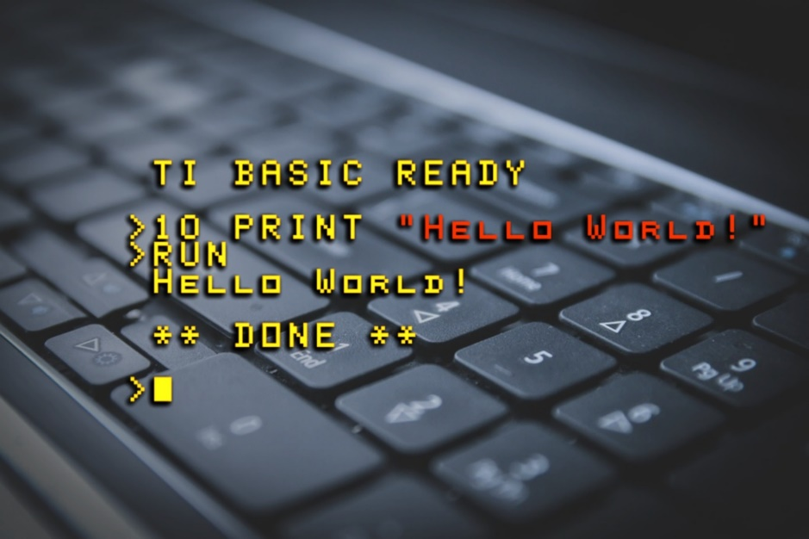
First Java Program

Slide 4
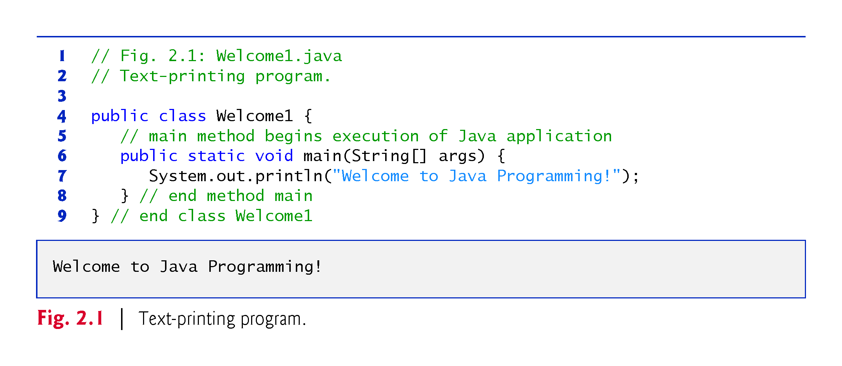
First Program in Java: Printing a Line of Text

Slide 5
First Program in Java: Printing a Line of Text
Commenting Your Programs
// Fig. 2.1: Welcome1.java
// indicates that the line is a comment.
Used to document programs and improve their readability.
Compiler ignores comments.
A comment that begins with // is an end-of-line comment
Traditional comment, can be spread over several lines as in
/* This is a traditional comment. It can be split over multiple lines */
This type of comment begins with /* and ends with */.
All text between the delimiters is ignored by the compiler.

Slide 6
First Program in Java: Printing a Line of Text
Using Blank Lines
Blank lines, space characters and tabs
Make programs easier to read.
Together, they’re known as white space (or whitespace).
White space is ignored by the compiler.
Used to document programs and improve their readability.

Slide 7
First Program in Java: Printing a Line of Text
Declaring a class
Class declaration
public class Welcome1
Every Java program consists of at least one class that you define.
class keyword introduces a class declaration and is immediately followed by the class name.
Keywords are reserved for use by Java and are always spelled with all lowercase letters.

Slide 8
First Program in Java: Printing a Line of Text
Java Reserved Keywords
abstract
assert
boolean
break
byte
case
catch
char
class
const
continue
default
do
double
else
enum
extends
false
for
final
finally
float
goto
if
implements
import
instanceof
int
interface
long
native
new
null
package
private
protected
public
return
short
static
strictfp
super
switch
synchronized
this
throw
throws
transient
true
try
void
volatile
while

Slide 9
First Program in Java: Printing a Line of Text
Filename for a public Class
A public class must be placed in a file that has a name of the form ClassName.java, so class Welcome1 is stored in the file Welcome1.java.
Class Body
A left brace, {, begins the body of every class declaration.
A corresponding right brace, }, must end each class declaration.

Slide 10
First Program in Java: Printing a Line of Text
System.out object
Standard output object.
Allows a Java application to display information in the command window from which it executes.
System.out.println method
Displays (or prints) a line of text in the command window.
The string in the parentheses the argument to the method.
Positions the output cursor at the beginning of the next line in the command window.
Most statements end with a semicolon.

Slide 11
First Program in Java: Printing a Line of Text
Compiling Your First Java Application
To compile the program, type
javac Welcome1.java
If the program contains no compilation errors, preceding command creates a .class file (known as the class file) containing the platform-independent Java bytecodes that represent the application.
When we use the java command to execute the application on a given platform, these bytecodes will be translated by the JVM into instructions that are understood by the underlying operating system.

Slide 12
First Program in Java: Printing a Line of Text
Executing the Welcome1 Application
To execute this program in a command window, change to the directory containing Welcome1.java
C:\examples\ch02\fig02_01 on Microsoft Windows or
~/Documents/examples/ch02/fig02_01 on Linux/macOS.
Next, type java Welcome1
This launches the JVM, which loads the Welcome1.class file.
The command omits the .class file-name extension; otherwise, the JVM will not execute the program.
The JVM calls class Welcome1’s main method.

Slide 13
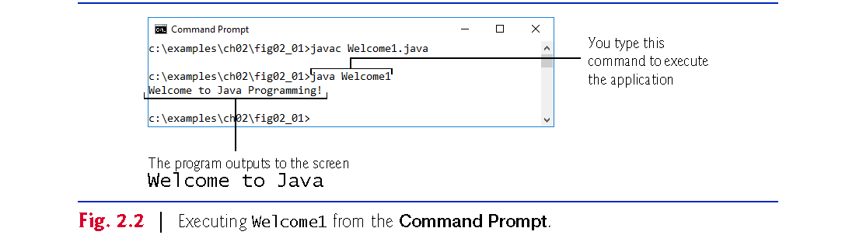
First Program in Java: Printing a Line of Text
Executing the Welcome1 Application

Slide 14
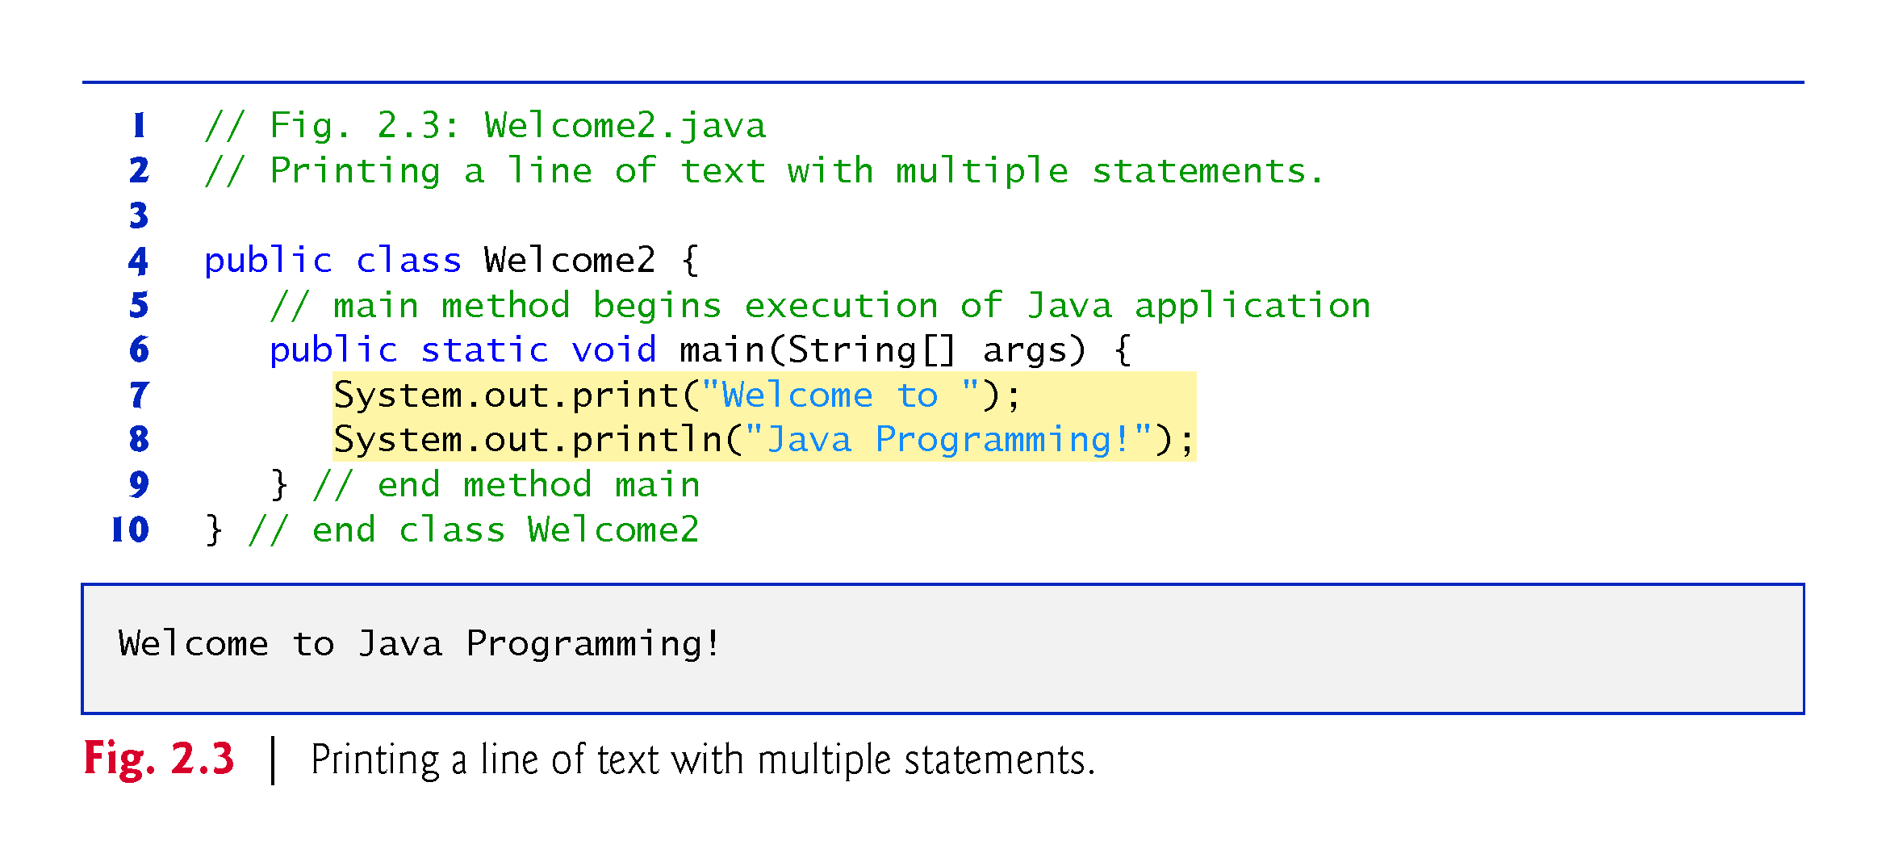
Modifying Your First Java Program
System.out’s method print displays a string.
Unlike println, print does not position the output cursor at the beginning of the next line in the command window.

Slide 15
Modifying Your First Java Program
Newline characters indicate to System.out’s print and println methods when to position the output cursor at the beginning of the next line in the command window.
Newline characters are whitespace characters.
The backslash (\) is called an escape character.
Indicates a “special character”
Backslash is combined with the next character to form an escape sequence \n represents the newline character.

Slide 16
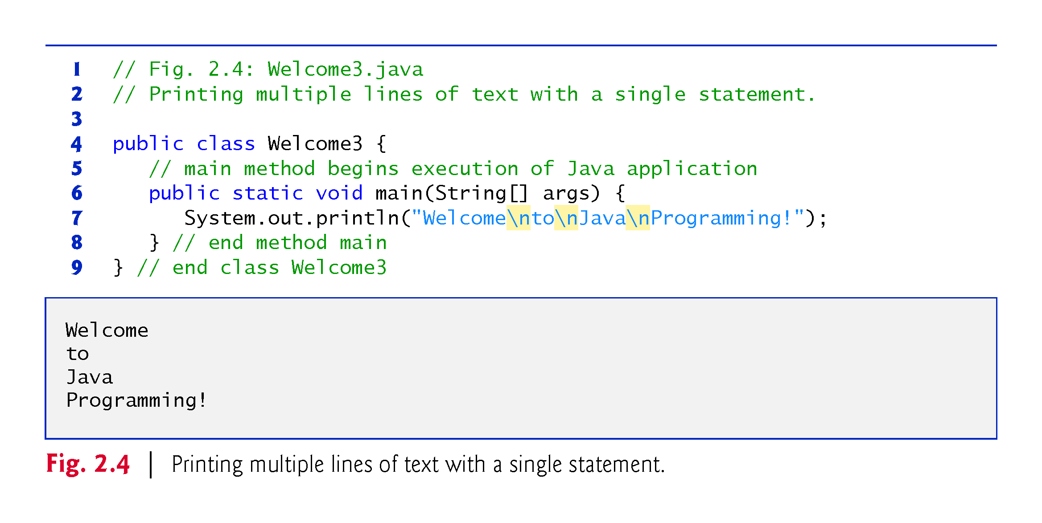
Modifying Your First Java Program

Slide 17
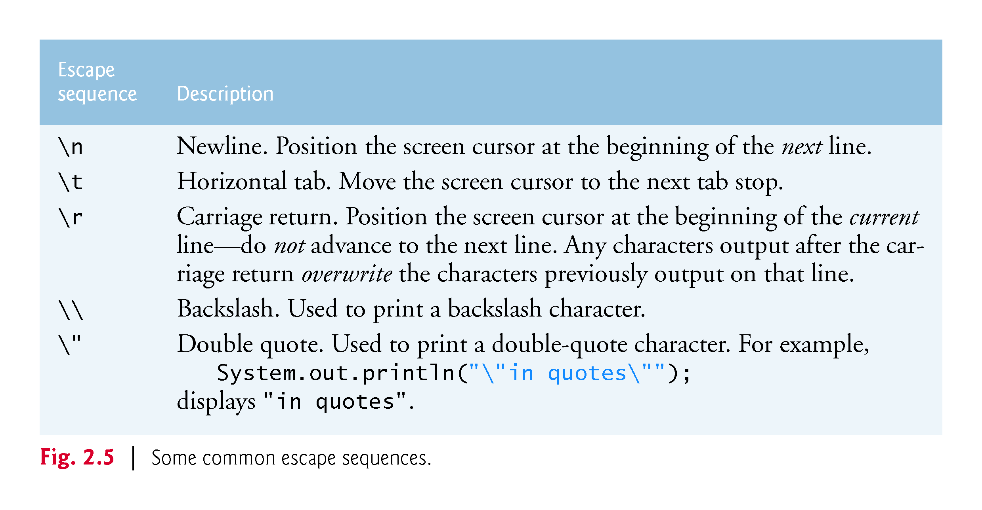
Escape Sequences

Slide 18
Variables and Literals
A variable is a named storage location in the computer’s memory.
A literal is a value that is written into the code of a program.
Programmers determine the number and type of variables a program will need.
public class Variable {
public static void main(String[] args) {
int value; //declaration of a variable
value = 5; // value assignment to the variable
System.out.print("The value is ");
System.out.println(value);
}
}
//The value is 5

Slide 19
Variables and Literals
This line is called
a variable declaration.
int value;
The following line is known
as an assignment statement.
value = 5;
0x000
The value 5
is stored in
memory.
0x001
5
0x002
0x003
This is a string literal. It will be printed as is.
System.out.print("The value is ");
System.out.println(value);
The integer 5 will
be printed out here.
Notice no quote marks?

Slide 20
The + Operator
The + operator can be used in two ways.
as a concatenation operator
as an addition operator
If either side of the + operator is a string, the result will be a string.
System.out.println("Hello " + "World");
System.out.println("The value is: " + 5);
System.out.println("The value is: " + value);
System.out.println("The value is: " + '\n' + 5);

Slide 21
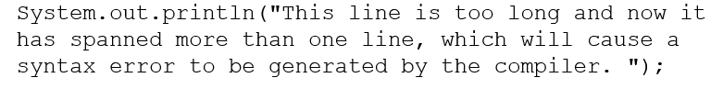
String Concatenation
Java commands that have string literals must be treated with care.
A string literal value cannot span lines in a Java source code file.
Fix with “+”
System.out.println("These lines are " +
"are now ok and will not " +
"cause the error as before.");
Can join various data types.
System.out.println("We can join a string to " +
"a number like this: " + 5);

Slide 22
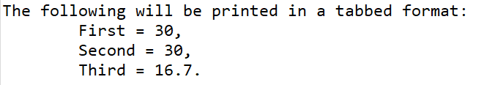
String Concatenation
Can be used to format complex String objects.
System.out.println("The following will be printed " +
"in a tabbed format: " +
"\n\tFirst = " + 5 * 6 + ", " +
"\n\tSecond = " + (5 * 6) + ", " +
"\n\tThird = " + 16.7 + ".");
if an addition operation is also needed, it must be put in parenthesis
Output

Slide 23
Identifiers
Identifiers are programmer-defined names for:
Classes , variables , methods
Identifiers may not be any of the Java reserved keywords.
Identifiers must follow certain rules, it may only contain:
letters a–z or A–Z,
the digits 0–9,
underscores (_), or
the dollar sign ($)
The first character may not be a digit.
Identifiers are case sensitive.
itemsOrdered is not the same as itemsordered.
Identifiers cannot include spaces.

Slide 24

Variables
A variable must be declared by specifying its name and the type of data that it will hold
data type
variable name
Multiple variables can be created in one declaration
int total;
int count, temp, result;
Always choose meaningful and descriptive variable names

Slide 25
Variable Names
Variable names should be descriptive.
Descriptive names allow the code to be more readable; therefore, the code is more maintainable.
Which of the following is more descriptive?
double tr = 0.0725;
double salesTaxRate = 0.0725;
Java programs should be self-documenting.

Slide 26
Java Naming Conventions
Variable names should begin with a lower case letter and then switch to title case thereafter:
Ex: int caTaxRate
Class names should be all title case.
Ex: public class BigLittle
More Java naming conventions can be found at:
http://java.sun.com/docs/codeconv/html/CodeConventions.doc8.html

Slide 27
Primitive Data Types

Slide 28
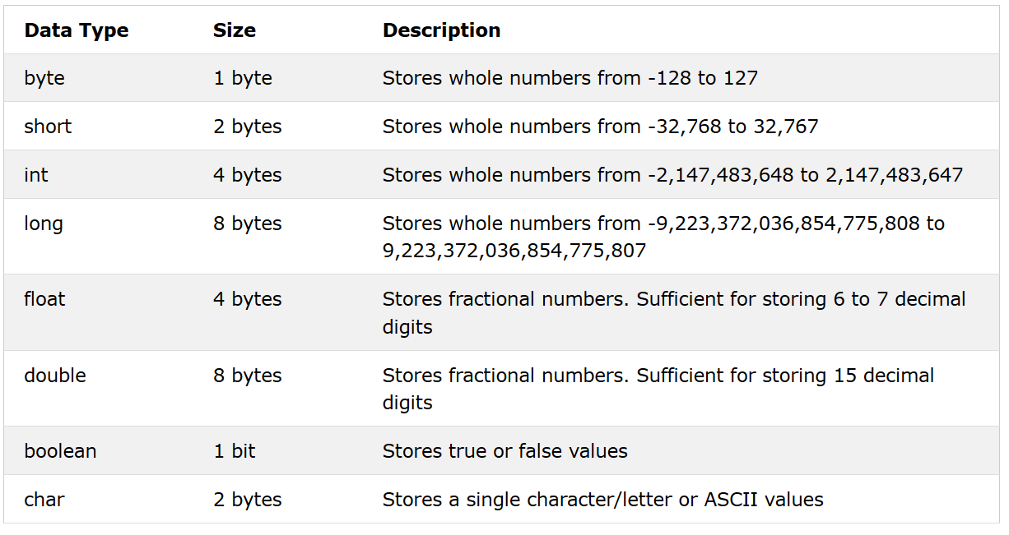
Primitive Data Types
Primitive data types are built into the Java language and are not derived from classes. There are 8 Java primitive data types.

Slide 29
Variable Declarations
Variable Declarations take the following form:
DataType VariableName;
byte inches;
short month;
int speed;
long timeStamp;
float salesCommission;
double distance;

Slide 30
Integer Data Types
byte, short, int, and long are all integer data types.
They can hold whole numbers such as 5, 10, 23, 89, etc.
Integer data types cannot hold numbers that have a decimal point in them.

Slide 31
Floating Point Data Types
Data types that allow fractional values are called floating-point numbers.
1.7 and -45.316 are floating-point numbers.
In Java there are two data types that can represent floating-point numbers.
float - also called single precision (7 decimal points).
double - also called double precision (15 decimal points).
They can hold whole numbers such as 5, 10, 23, 89, etc.
Integer data types cannot hold numbers that have a decimal point in them.

Slide 32
Floating Point Literals
When floating point numbers are embedded into Java source code they are called floating point literals.
The default type for floating point literals is double.
29.75, 1.76, and 31.51 are double data types.
A double value is not compatible with a float variable because of its size and precision.
float number;
number = 23.5; // Error!
A double can be forced into a float by appending the letter F or f to the literal.
float number;
number = 23.5F; // This will work.

Slide 33
Scientific and E Notation
Floating-point literals can be represented in scientific notation.
Decimal Notation | Scientific Notation | E Notation
247.91 | 2.4791 x 10² | 2.4791E2
0.00072 | 7.2 x 10⁻⁴ | 7.2E-4
2,900,000 | 2.9 x 10⁶ | 2.9E6

Slide 34
The boolean Data
The Java boolean data type can have two possible values.
true
false
The value of a boolean variable may only be copied into a boolean variable.
boolean done = false;

Slide 35
The char Data Type
The Java char data type provides access to single characters.
Don’t confuse char literals with string literals.
char literals are enclosed in single quotes.
String literals are enclosed in double quotes.
Character literals are delimited by single quotes:
'a' 'X' '7' '$' ',' '\n'
Example declarations
char topGrade = 'A';
char terminator = ';', separator = ' ';

Slide 36
Unicode
Internally, characters are stored as numbers.
Each character takes up 2 bytes in memory.
The first 256 characters in the Unicode character set are compatible with the ASCII* character set.
*American Standard Code for Information Interchange
The decimal values
represent these
characters.
A
B
Characters are
stored in memory as binary numbers.
The binary numbers
represent these
decimal values.
00
65
00
66
0
0
0
0
0
0
0
0
0
1
0
0
0
0
0
1
0
0
0
0
0
0
0
0
0
1
0
0
0
0
1
0

Slide 37
Variable Assignment and Initialization
In order to store a value in a variable, an assignment statement must be used. The assignment operator is the equal (=) sign.
Left side of the assignment operator must be a variable name.
Right side must be either a literal or expression that evaluates to a type that is compatible with the type of the variable.
int month; // Once declared, they can then receive a value
month = 2; //After receiving a value, variables can then be used
int days = 28; //Can be declared and initialized on he same line.
System.out.println("Month " + month + " has " + days + " Days.");

Slide 38

Implicit type using var
Java 10 and above has var keyword to declare a variable without explicit type
e.g. instead of doing
String str = "Java" ;
You can just say
var str = "Java" ;
Java will implicitly recognize the variable data type based on the initial value assigned to it
This will be heavily used in this course!

Slide 39
Trace a Program Execution
animation
allocate memory for radius
public class ComputeArea {
/** Main method */
public static void main(String[] args) {
double radius;
double area;
// Assign a radius
radius = 20;
// Compute area
area = radius * radius * 3.14159;
// Display results
System.out.println("The area for the
circle of radius " +
radius + " is " + area);
}
}
radius
no value

Slide 40
Trace a Program Execution
animation
public class ComputeArea {
/** Main method */
public static void main(String[] args) {
double radius;
double area;
// Assign a radius
radius = 20;
// Compute area
area = radius * radius * 3.14159;
// Display results
System.out.println("The area for the
circle of radius " +
radius + " is " + area);
}
}
memory
radius
no value
area
no value
allocate memory for area

Slide 41
Trace a Program Execution
animation
public class ComputeArea {
/** Main method */
public static void main(String[] args) {
double radius;
double area;
// Assign a radius
radius = 20;
// Compute area
area = radius * radius * 3.14159;
// Display results
System.out.println("The area for the circle of radius " +
radius + " is " + area);
}
}
assign 20 to radius
radius
20
area
no value

Slide 42
Trace a Program Execution
animation
public class ComputeArea {
/** Main method */
public static void main(String[] args) {
double radius;
double area;
// Assign a radius
radius = 20;
// Compute area
area = radius * radius * 3.14159;
// Display results
System.out.println("The area for the circle of radius " +
radius + " is " + area);
}
}
memory
radius
20
area
1256.636
compute area and assign it to variable area

Slide 43

Trace a Program Execution
animation
public class ComputeArea {
/** Main method */
public static void main(String[] args) {
double radius;
double area;
// Assign a radius
radius = 20;
// Compute area
area = radius * radius * 3.14159;
// Display results
System.out.println("The area for the circle of radius " +
radius + " is " + area);
}
}
memory
radius
20
area
1256.636
print a message to the console

Slide 44
Arithmetic Operations

Slide 45
Arithmetic Operators
Operator | Meaning | Type | Example
+ | Addition | Binary | total = cost + tax;
- | Subtraction | Binary | cost = total – tax;
* | Multiplication | Binary | tax = cost * rate;
/ | Division | Binary | salePrice = original / 2;
% | Modulus | Binary | remainder = value % 5;

Slide 46
Arithmetic Operators
Each operator must have a left and right operand.
The arithmetic operators work as one would expect.
It is an error to try to divide any number by zero.
When working with two integer operands, the division operator requires special attention
Integer Division
In a Java program, what is the value of 1/2?
You might think the answer is 0.5…
But, that’s wrong.
The answer is simply 0.
Integer division will truncate any decimal remainder.

Slide 47
Operator Precedence
Operator | Associativity | Example | Result
- (unary negation) | Right to left | x = -4 + 3; | -1
* / % | Left to right | x = -4 + 4 % 3 * 13 + 2; | 11
+ - | Left to right | x = 6 + 3 – 4 + 6 * 3; | 23
Higher Priority
Lower Priority

Slide 48
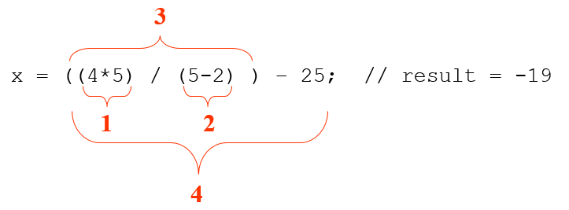
Grouping with Parenthesis
When parenthesis are used in an expression, the inner most parenthesis are processed first.
If two sets of parenthesis are at the same level, they are processed left to right.

Slide 49
Combined Assignment Operators
Operator | Example | Equivalent | Value of variable after operation
+= | x += 5; | x = x + 5; | The old value of x plus 5.
-= | y -= 2; | y = y – 2; | The old value of y minus 2
*= | z *= 10; | z = z * 10; | The old value of z times 10
/= | a /= b; | a = a / b; | The old value of a divided by b.
%= | c %= 3; | c = c % 3; | The remainder of the division of the old value of c divided by 3.

Slide 50
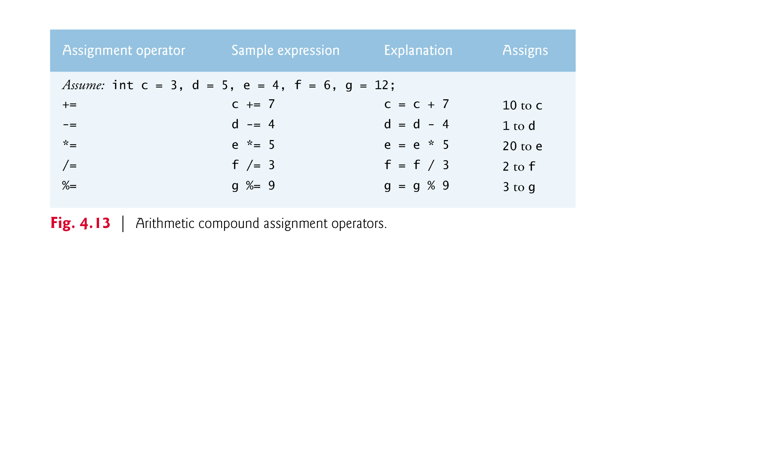
Combined Assignment Operators
Example

Slide 51
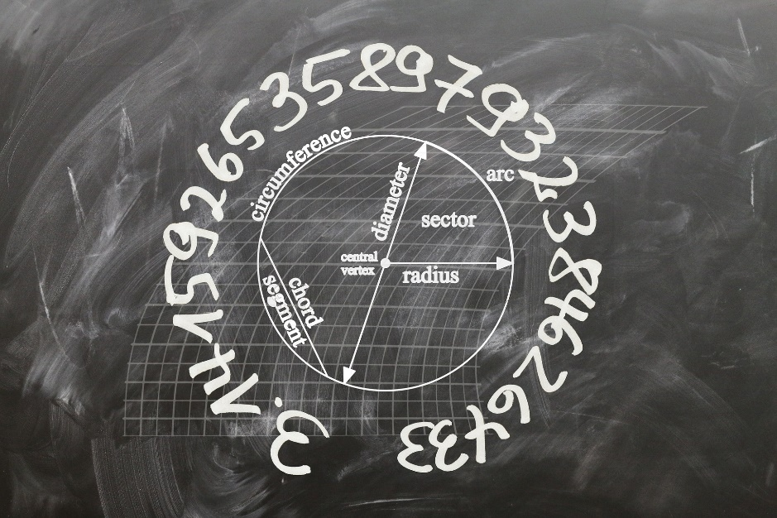
Constants

Slide 52
Creating Constants
Constants keep the program organized and easier to maintain.
Can hold only a single value.
Constants are declared using the keyword final.
Constants need not be initialized when declared; however, they must be initialized before they are used or a compiler error will be generated.
Once initialized with a value, constants cannot be changed programmatically.
By convention, constants are all upper case and words are separated by the underscore character.
final int STUDENT_COUNT = 10;
final double CAL_SALES_TAX = 0.725;

Slide 53
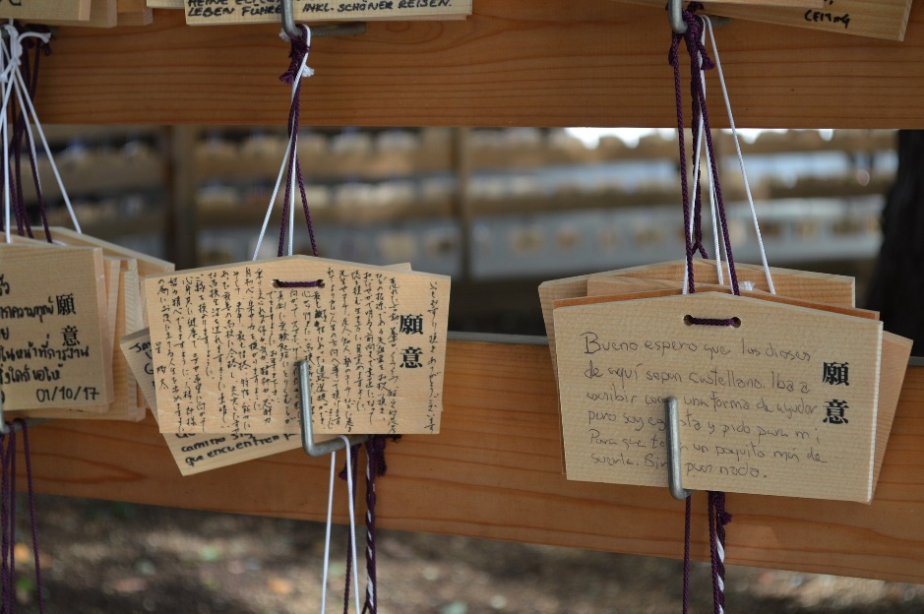
The String Class

Slide 54
The String Class
Java has no primitive data type that holds a series of characters.
The String class from the Java standard library is used for this purpose.
In order to be useful, the a variable must be created to reference a String object.
String number;
Notice the S in String is upper case.

Slide 55
String Objects
A variable can be assigned a String literal.
String value = "Hello";
Strings are the only objects that can be created in this way.
A variable can be created using the new keyword.
String value = new String("Hello");
This is the method that all other objects must use when they are created.
Many useful builtin methods:
contains, startsWith, endsWith, indexOf,substring, split, replace, toUpperCase, toLowerCase, equals
Use equals (not ==) to compare strings
String name = "Ali";
name.equals("Ali"); // --> true

Slide 56
String Methods
String Length:
String txt = "Be yourself; everyone else is already taken.";
System.out.println("The length of the txt string is: " + txt.length());
Uppercase and Lowercase:
String txt = "Hello World";
System.out.println(txt.toUpperCase()); // Outputs "HELLO WORLD"
System.out.println(txt.toLowerCase()); // Outputs "hello world"
Finding a Character in a String: indexOf() method returns the index (the position) of the first occurrence of a specified text in a string (including whitespace):
String txt = "Please locate where 'locate' occurs!";
System.out.println(txt.indexOf("locate")); // Outputs 7

Slide 57
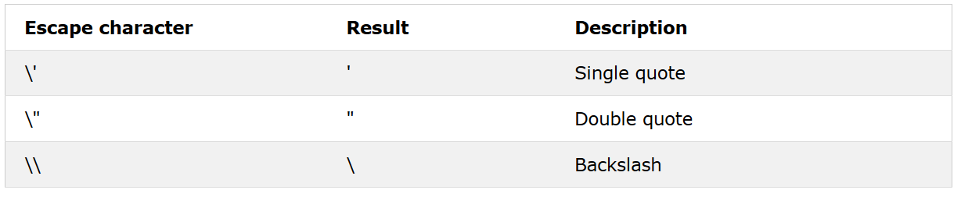
Special Characters
Because strings must be written within quotes, Java will misunderstand this string, and generate an error:
The solution to avoid this problem, is to use the backslash escape character.
The backslash (\) escape character turns special characters into string characters:

Slide 58
Special Characters
String viking = "We are the so-called \"Vikings\" from the north.";
String right = "It\'s alright.";
String lines = "this is one line \nThis is the next line\n";
System.out.println(viking); //We are the so-called "Vikings" from the north.
System.out.println(right); //It's alright.
System.out.println(lines); //this is one line //This is the next line

Slide 59
Using System.out for Screen Output
Commonly used methods:
print(String line) will send line to output
println(String line) will send line to output, followed by a line break println() will send just the line break to output
printf(formatString, argumentList)
double price = 19.8;
String name = "magic apple";
System.out.printf("$%.2f for each %s.", price, name);
will output
$19.80 for each magic apple
The formatString contains 2 format specifiers (%.2f and %s) that match the two arguments (price and name)
The format specifier "%.2f" indicates displaying 2 digits after the decimal point
Notes:
(this is a newline or carriage return, but it depends on system)
formatstring is a string literal with format specifiers
argumentlist is comma separated list of data to print
argumentlist items must match format specifiers in order left to right

Slide 60
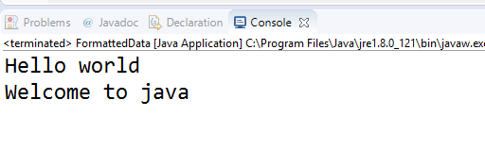
Display formatted Data
public class FormattedData {
public static void main(String arg[])
{
System.out.printf("%s\n%s","Hello world","Welcome to java");
}
}
Format
The format %s is a placeholder for a string
\n inserts a line break

Slide 61
Displaying Text with printf
System.out.printf method : f means “formatted”
Displays formatted data
Multiple method arguments are placed in a comma-separated list.
Method printf’s first argument is a format string
May consist of fixed text and format specifiers.
Fixed text is output as it would be by print or println.
Each format specifier is a placeholder for a value and specifies the type of data to output.
Format specifiers begin with a percent sign (%) and are followed by a character that represents the data type.
Format specifier %s is a placeholder for a string.

Slide 62
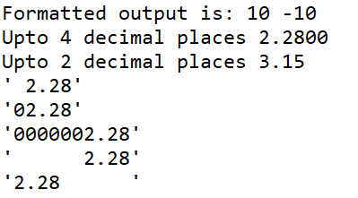
Displaying Text with printf - examples
//Number Formatting
int x = 10;
System.out.printf("Formatted output is: %d %d%n", x, -x);
float y = 2.28f;
System.out.printf("Upto 4 decimal places %.4f\n",y);
float z = 3.147293165f;
System.out.printf("Upto 2 decimal places %.2f\n",z);
//Width Specifier, Aligning, Fill With Zeros
System.out.printf("'%5.2f'%n", 2.28);
System.out.printf("'%05.2f'%n", 2.28);
System.out.printf("'%010.2f'%n", 2.28);
//Aligning By default, it is a + which means right aligned.
System.out.printf("'%10.2f'%n", 2.28);
System.out.printf("'%-10.2f'%n", 2.28); //Align left

Slide 63
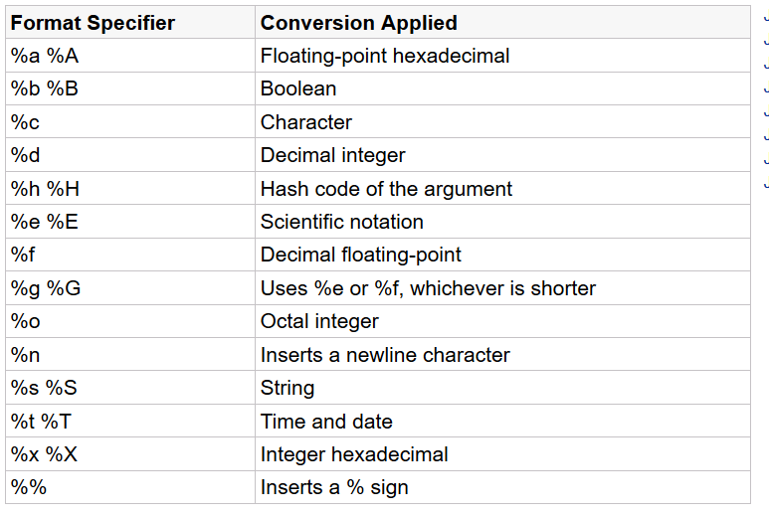
Common Format Specifiers

Slide 64

Java User Input (Scanner)

Slide 65
The Scanner Class
To read input from the keyboard we can use the Scanner class.
The Scanner class is defined in java.util, so we will use the following statement at the top of our programs:
import java.util.Scanner;
Scanner objects work with System.in
To create a Scanner object:
Scanner keyboard = new Scanner (System.in);
Scanner myObj = new Scanner(System.in); // Create a Scanner object
System.out.println("Enter username");
String userName = myObj.nextLine(); // Read user input
System.out.println("Username is: " + userName); // Output user input

Slide 66
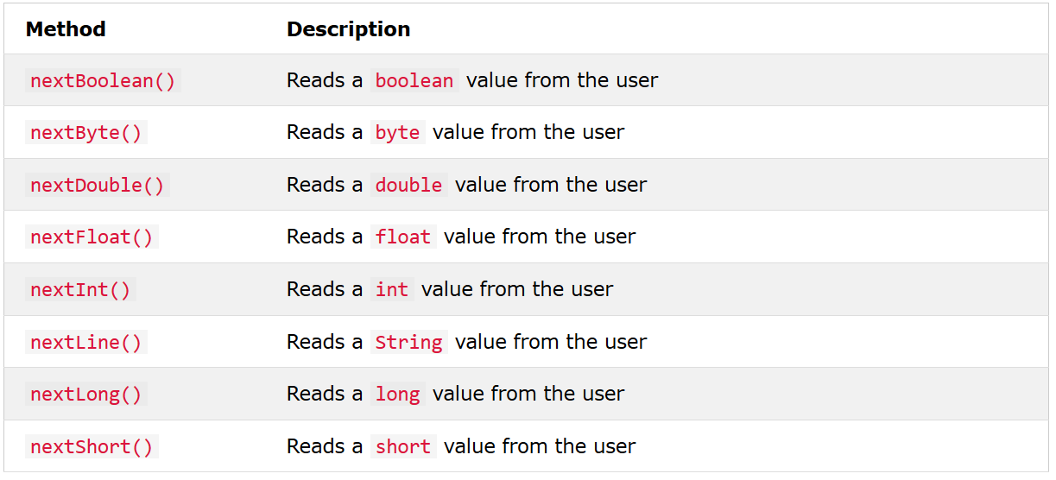
The Scanner Class : Input Types

Slide 67
The Scanner Class : Input Types Example
import java.util.Scanner; //Always needed with input
public class TextScanner {
public static void main(String[] args) {
Scanner myObj = new Scanner(System.in);
System.out.println("Enter name, age and salary:");
// String input
String name = myObj.nextLine();
// Numerical input
int age = myObj.nextInt(); // integer input
double salary = myObj.nextDouble(); //double input
// Output input by user
System.out.println("Name: " + name);
System.out.println("Age: " + age);
System.out.println("Salary: " + salary);
myObj.close();
}
}

Slide 68

Example-1: Area of a Circle
package simple;
import java.util.Scanner;
public class CircleArea {
public static void main(String[] args) {
final double PI = 3.14159265359;
double radius, area;
Scanner input = new Scanner(System.in);
System.out.println("Enter the radius: ");
radius = input.nextDouble();
area = PI * radius * radius;
System.out.println("Area =" + area);
}
}

Slide 69
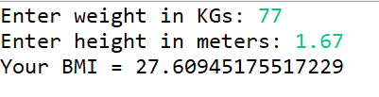
Example-2: BMI Calculator
package simple;
import java.util.Scanner;
public class BMICalc {
public static void main(String[] args) {
double weight, height, BMI;
Scanner input = new Scanner(System.in);
System.out.print("Enter weight in KGs: ");
weight = input.nextDouble();
System.out.print("Enter height in meters: ");
height = input.nextDouble();
BMI = weight/(height*height);
System.out.println("Your BMI = " + BMI);
}
}

Slide 70
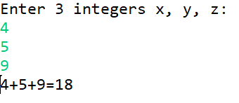
Example-3: Adding 3 Integers
package simple;
import java.util.Scanner;
public class AddIntegers {
public static void main(String[] args) {
Scanner input = new Scanner(System.in);
int x, y, z, sum;
System.out.println("Enter 3 integers x, y, z: ");
x = input.nextInt();
y = input.nextInt();
z = input.nextInt();
sum = x+y+z;
System.out.println(x + "+" + y + "+" + z + "=" + sum);
}
}

Slide 71
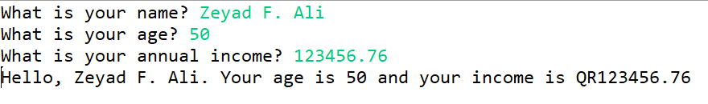
Example-4: Input /Output
package simple;
import java.util.Scanner; // Needed for the Scanner class
public class InputOutput {
public static void main(String[] args)
{
String name; // To hold the user's name
int age; // To hold the user's age
double income; // To hold the user's income
// Create a Scanner object to read input.
Scanner input = new Scanner(System.in);
// Get the user's name.
System.out.print("What is your name? ");
name = input.nextLine();
// Get the user's age.
System.out.print("What is your age? ");
age = input.nextInt();
// Get the user's income
System.out.print("What is your annual income? ");
income = input.nextDouble();
// Display the information back to the user.
System.out.println("Hello, " + name + ". Your age is " +
age + " and your income is QR" + income);
} }

Slide 72
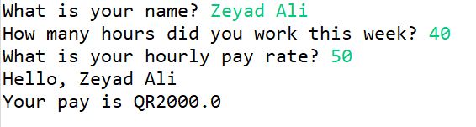
Example-5: Payroll Calculation
package simple;
import java.util.Scanner; // Needed for the Scanner class
public class PayrollCalc {
public static void main(String[] args) {
String name; // To hold a name
int hours; // Hours worked
double payRate; // Hourly pay rate
double pay; // Gross pay
// Create a Scanner object to read input.
Scanner input = new Scanner(System.in);
// Get the user's name.
System.out.print("What is your name? ");
name = input.nextLine();
// Get the number of hours worked this week.
System.out.print("How many hours did you work this week? ");
hours = input.nextInt();
// Get the user's hourly pay rate.
System.out.print("What is your hourly pay rate? ");
payRate = input.nextDouble();
// Calculate the pay.
pay = hours * payRate;
// Display the resulting information.
System.out.println("Hello, " + name);
System.out.println("Your pay is QR" + pay);
}}

Slide 73
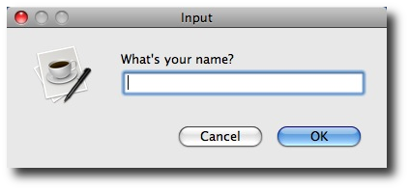
Dialog Boxes

Slide 74
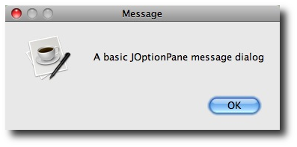
Dialog Boxes
A dialog box is a small graphical window that displays a message to the user or requests input.
A variety of dialog boxes can be displayed using the JOptionPane class.
Two of the dialog boxes are:
Message Dialog - a dialog box that displays a message.
Input Dialog - a dialog box that prompts the user for input.

Slide 75
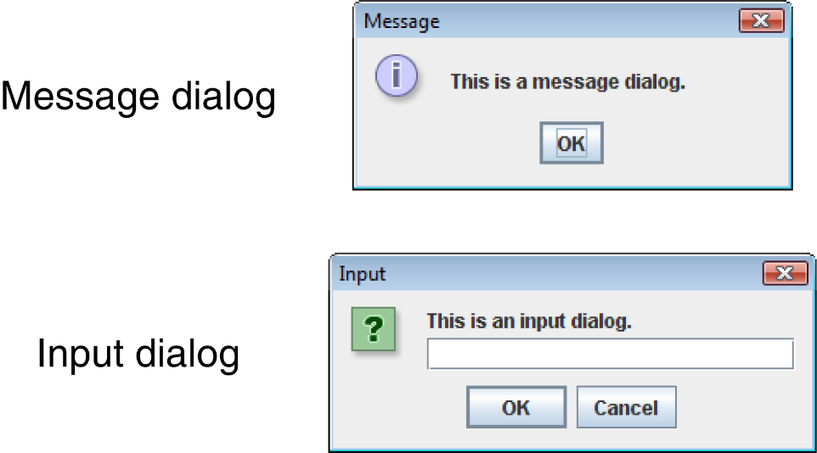
The JOptionPane Class
The JOptionPane class is not automatically available to your Java programs.
The following statement must be before the program’s class header:
import javax.swing.JOptionPane;
This statement tells the compiler where to find the JOptionPane class.

Slide 76
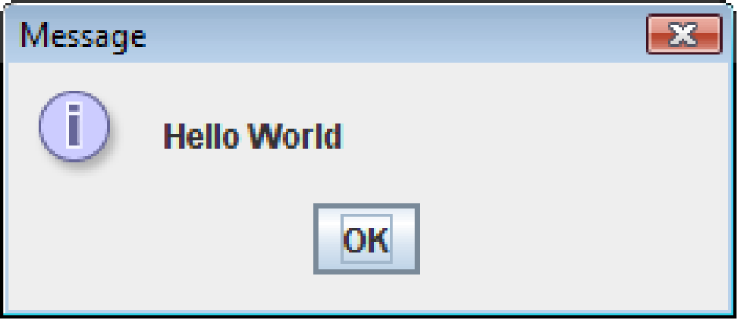
Message Dialogs
JOptionPane.showMessageDialog method is used to display a message dialog.
JOptionPane.showMessageDialog(null, "Hello World");
The first argument will be discussed later.
The second argument is the message that is to be displayed.

Slide 77
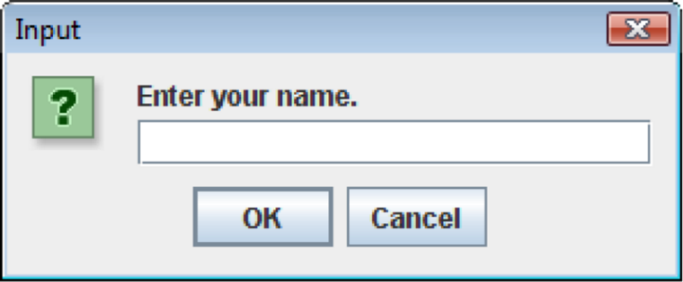
Input Dialogs
An input dialog is a quick and simple way to ask the user to enter data.
The dialog displays a text field, an Ok button and a Cancel button.
If Ok is pressed, the dialog returns the user’s input.
If Cancel is pressed, the dialog returns null
String name;
name = JOptionPane.showInputDialog("Enter your name.");
The argument passed to the method is the message to display.
If the user clicks on the OK button, name references the string entered by the user. If the user clicks on the Cancel button, name references null.

Slide 78
The System.exit Method
A program that uses JOptionPane does not automatically stop executing when the end of the main method is reached.
Java generates a thread, which is a process running in the computer, when a JOptionPane is created.
If the System.exit method is not called, this thread continues to execute.
The System.exit method requires an integer argument: System.exit(0);
This argument is an exit code that is passed back to the operating system.
This code is usually ignored, however, it can be used outside the program to indicate whether the program ended successfully or as the result of a failure.
The value 0 traditionally indicates that the program ended successfully.

Slide 79
Converting a String to a Number
The JOptionPane’s showInputDialog method always returns the user's input as a String
A String containing a number, such as “127.89” can be converted to a numeric data type.
Each of the numeric wrapper classes, (covered in Chapter 10) has a method that converts a string to a number.
The Integer class has a method that converts a string to an int,
The Double class has a method that converts a string to a double, and etc.
These methods are known as parse methods because their names begin with the word “parse.”

Slide 80
The Parse Methods
// Store 1 in bVar.
byte bVar = Byte.parseByte("1");
// Store 2599 in iVar.
int iVar = Integer.parseInt("2599");
// Store 10 in sVar.
short sVar = Short.parseShort("10");
// Store 15908 in lVar.
long lVar = Long.parseLong("15908");
// Store 12.3 in fVar.
float fVar = Float.parseFloat("12.3");
// Store 7945.6 in dVar.
double dVar = Double.parseDouble("7945.6");

Slide 81
Reading Numeric Values from an Input Dialog
Reading integers:
int number;
String str;
str = JOptionPane.showInputDialog("Enter a number.");
number = Integer.parseInt(str);
Reading doubles:
double price;
String str;
str = JOptionPane.showInputDialog("Enter the retail price.");
price = Double.parseDouble(str);

Slide 82
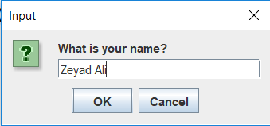
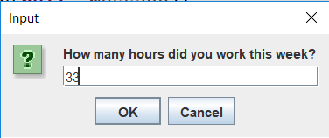
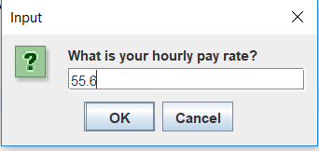
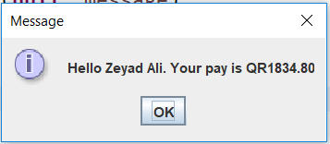
Example-6: Payroll Calculation Using Dialogs
package simple;
import javax.swing.JOptionPane;
public class InputOutputDialog {
public static void main(String[] args) {
String inputString; // For reading input
String name; // The user's name
int hours; // The number of hours worked
double payRate; // The user's hourly pay rate
double pay; // The user's gross pay
// Get the user's name.
name = JOptionPane.showInputDialog("What is your name? ");
// Get the hours worked.
inputString = JOptionPane.showInputDialog("How many hours did you work this week? ");
// Convert the input to an int.
hours = Integer.parseInt(inputString);
// Get the hourly pay rate.
inputString = JOptionPane.showInputDialog("What is your hourly pay rate? ");
// Convert the input to a double.
payRate = Double.parseDouble(inputString);
// Calculate the pay.
pay = hours * payRate;
// Display the results.
String message = String.format("Hello %s. Your pay is QR%.2f", name, pay);
JOptionPane.showMessageDialog(null, message);
// End the program.
System.exit(0);
}}

Slide 83
Java Type Casting
Type casting is when you assign a value of one primitive data type to another type.
In Java, there are two types of casting:
Widening/Promotion Casting (automatically) - converting a smaller type to a larger type size
byte -> short -> char -> int -> long -> float -> double
Narrowing/Demotion Casting (manually) - converting a larger type to a smaller size type
double -> float -> long -> int -> char -> short -> byte

Slide 84

Widening Casting
Widening casting is done automatically when passing a smaller size type to a larger size type:
int k = 3;
double c = k; // Automatic casting: int to double
System.out.println(k); // Outputs 3
System.out.println(c); // Outputs 3.0

Slide 85
Narrowing Casting
Narrowing casting must be done manually by placing the type in parentheses in front of the value:
double myDouble = 5.67;
int myInt = (int) myDouble; // Manual casting: double to int
System.out.println(myDouble); // Outputs 5.67
System.out.println(myInt); // Outputs 5

Slide 86
Packages and the import statement
Java Package:
A method to categorize classes and interfaces
Package name comes first in your java file
Import statements:
Import statement is a way of giving the proper location for the compiler to find that particular class.
In java if a fully qualified name, which includes the package and the class name, is given then the compiler can easily locate the classes.

Slide 87
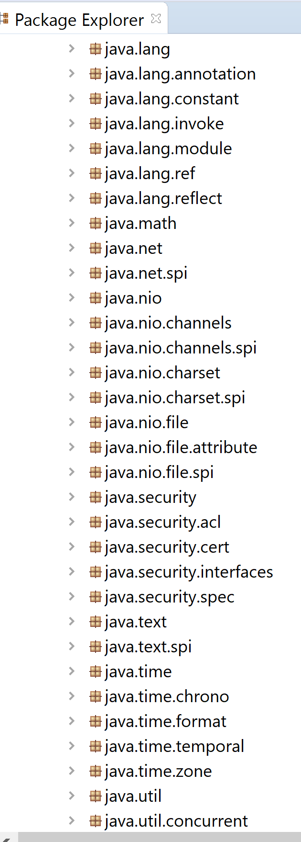
Built-in Packages
Java fundamental classes are in java.lang, classes for reading and writing (input and output) are in java.io, lists and collections in java.util and so on.
To use a class from a package, first import it. E.g.,
import java.util.Scanner;
Notes:
We can simply import a class providing the required functionality from an existing package and use it in our program.

Slide 88
Resources
More info and exercises @
https://www.w3schools.com/java/
https://www.javatpoint.com/java-tutorial
https://www.w3resource.com/java-exercises/basic/index.php

